Slide 1
AD698 - Applied Generative AI
Language, Probability, and Generative Systems Nakul R. Padalkar

Slide 2
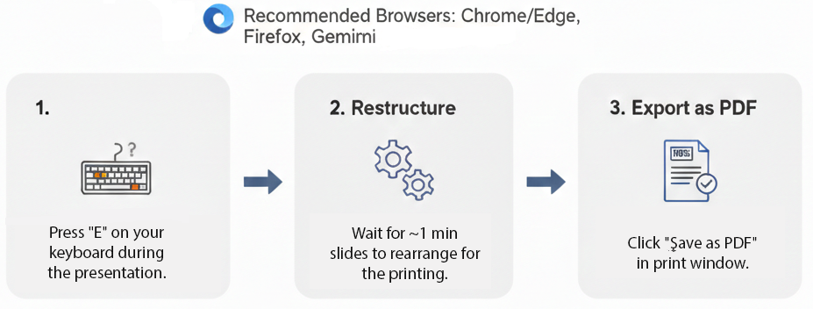
How to print Revealjs slides

Slide 3
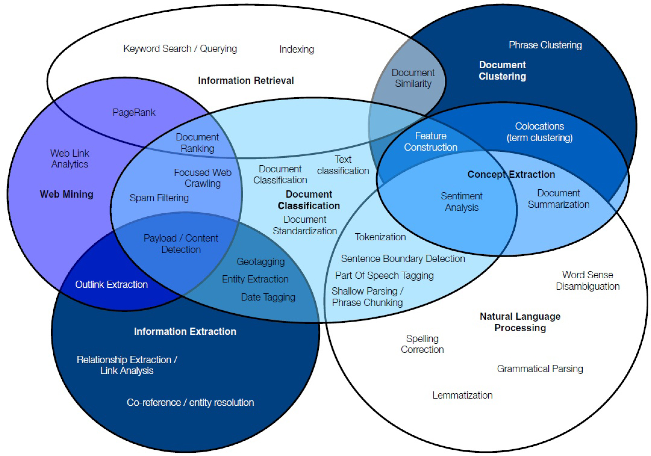
Text Analytics and Mining
Text Analytics
Figure 1. Text Analytics (Talib et al. 2016)

Slide 4
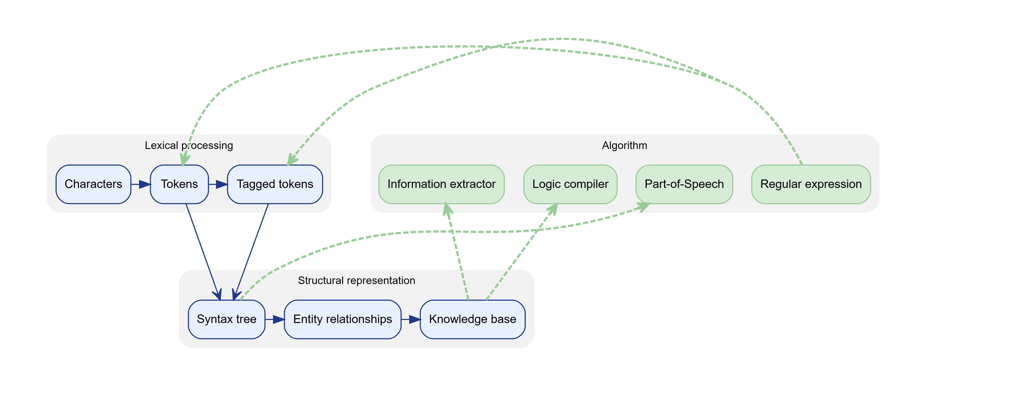
Text Mining Process

Slide 5
Text Analytics
Knowledge Discovery in Textual Databases
Text Mining is a subfield of Text Analytics and Natural Language Processing (NLP)
Text Analytics is a broader term that encompasses various techniques for analyzing and extracting insights from text data.
Borrows from various fields such as information retrieval, machine learning, statistics, linguistics, and others.
$$\begin{matrix}\text{Text Mining} & =\text{Information Extraction}+ \\ & ​\text{Data Mining}+\text{Web Mining} \\ \text{Text Analytics} & =\text{Information Retrieval}+\text{Text Mining}\end{matrix}$$
Application Areas of Text Mining
Information extraction
Topic tracking
Summarization
Categorization
Clustering
Concept linking
Question answering

Slide 6
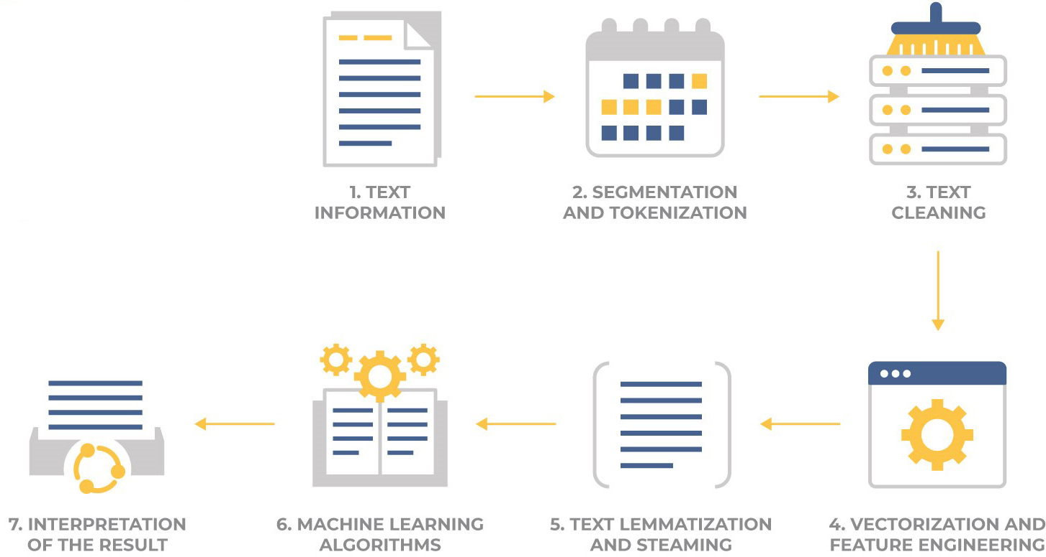
Text Mining and Analytics Process
Figure 2. NLP Pipeline

Slide 7
Sentiment Analysis

Slide 8
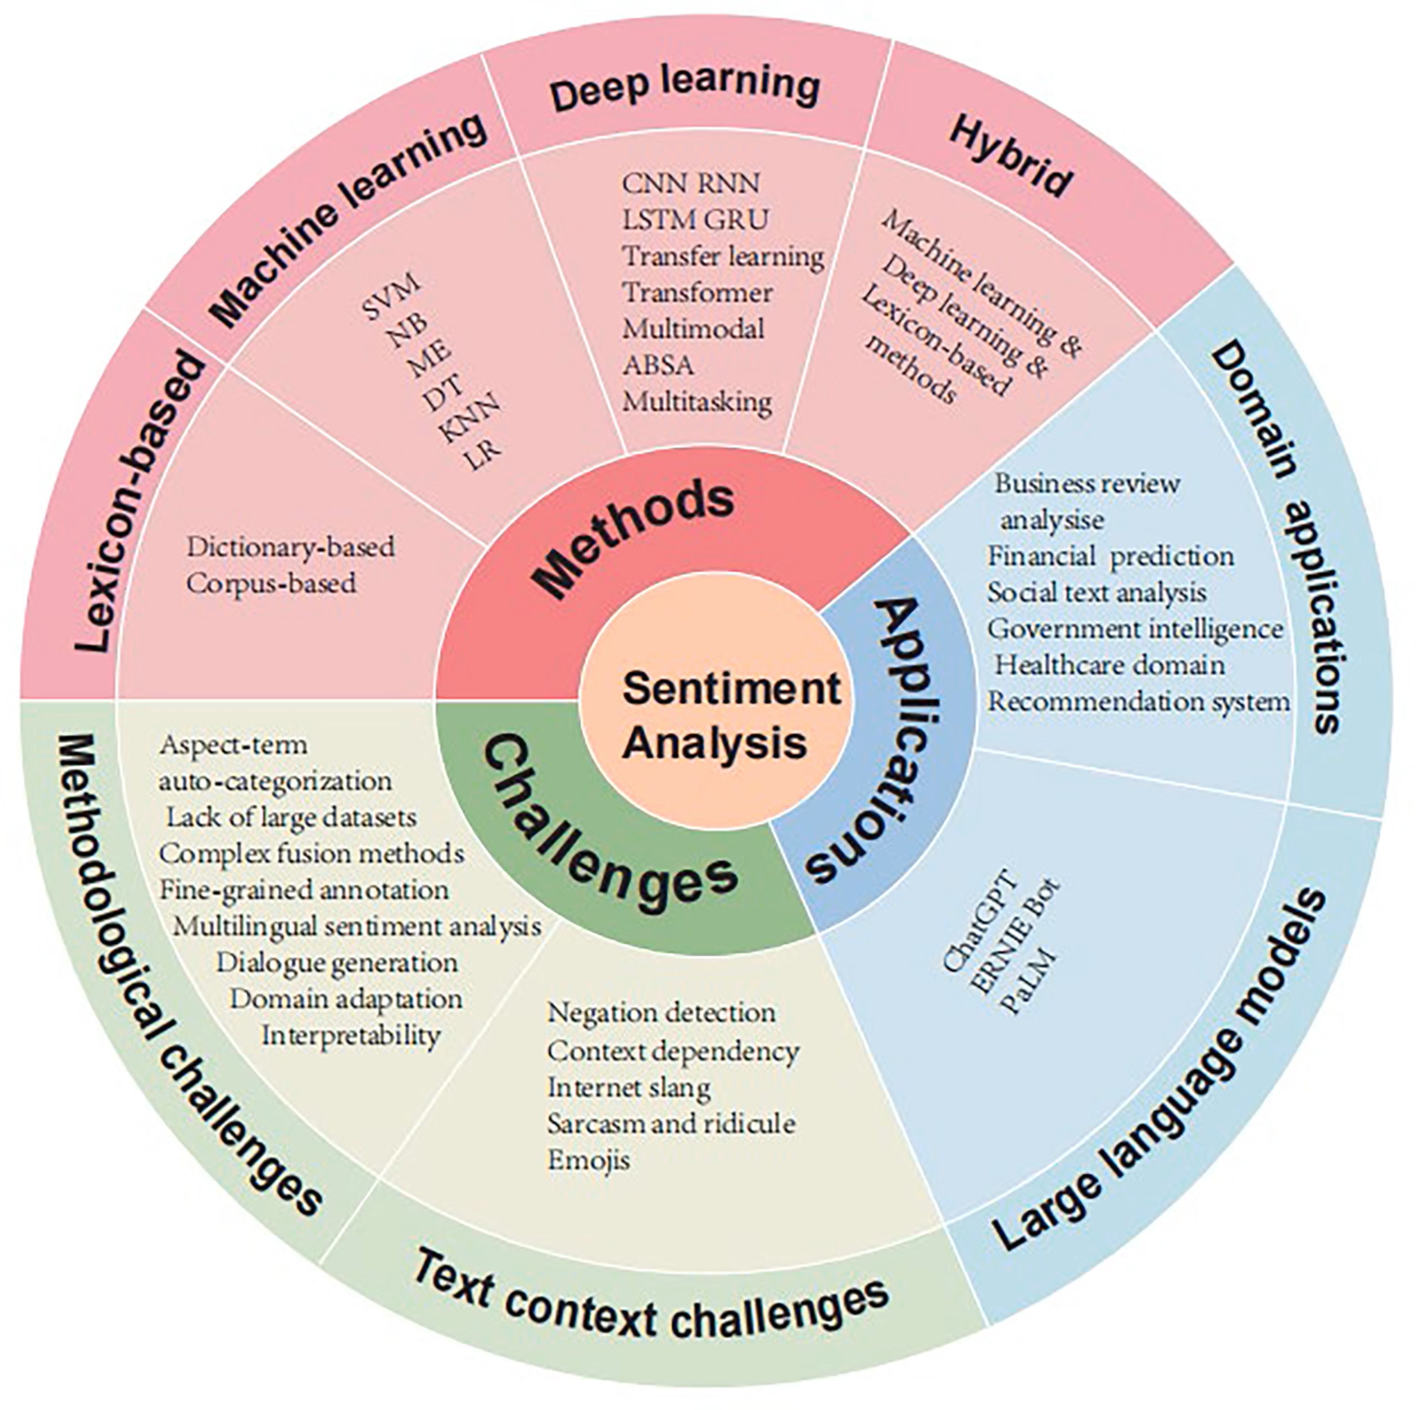
Methods
Lexicon-based
Machine Learning
Deep Learning
Hybrid
Applications
Domain Applications
Large Language Models
Challenges
Methodological Challenges
Text Context Challenges
Figure 3. Sentiment Analysis: tasks, tools, methods, and applications

Slide 9
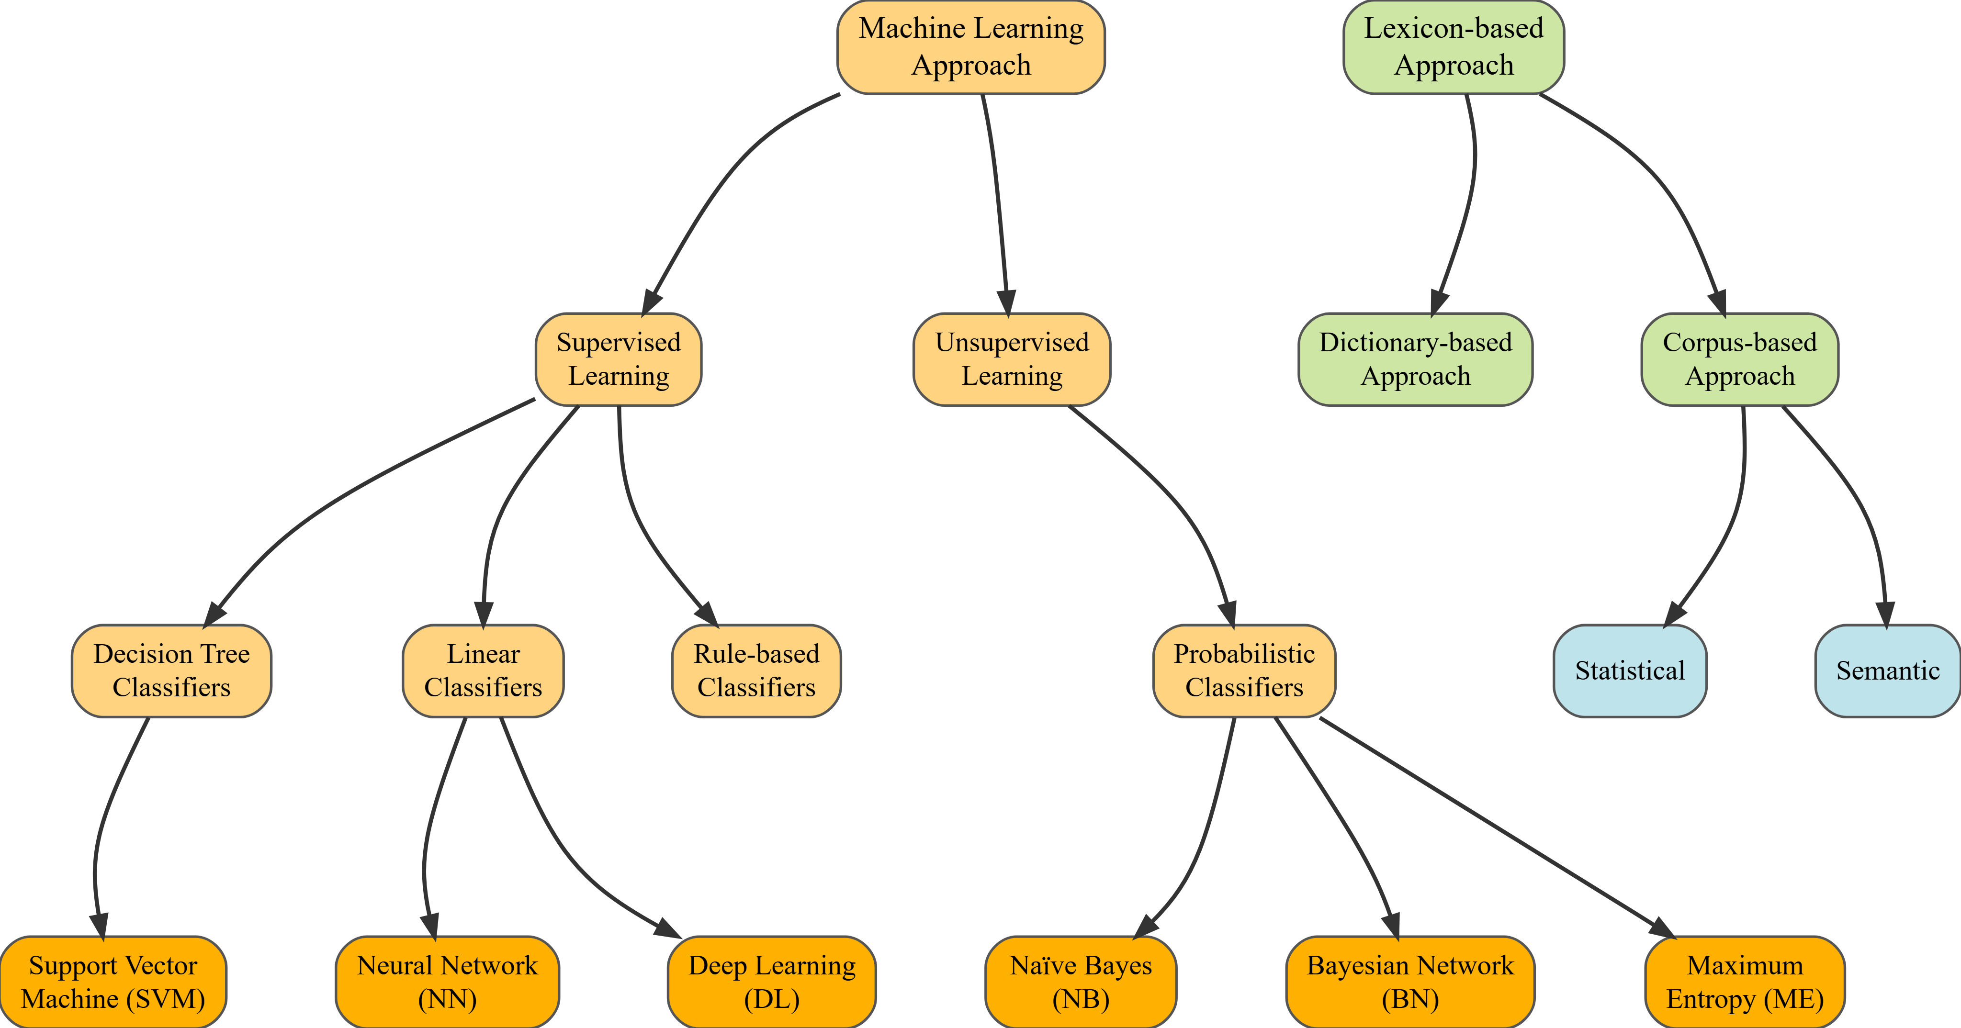
Sentiment Classification Algorithms

Slide 10
Types of Sentiment Analysis
Aspects-based
Emotion-based
Fine-grained
Intent-based

Slide 11
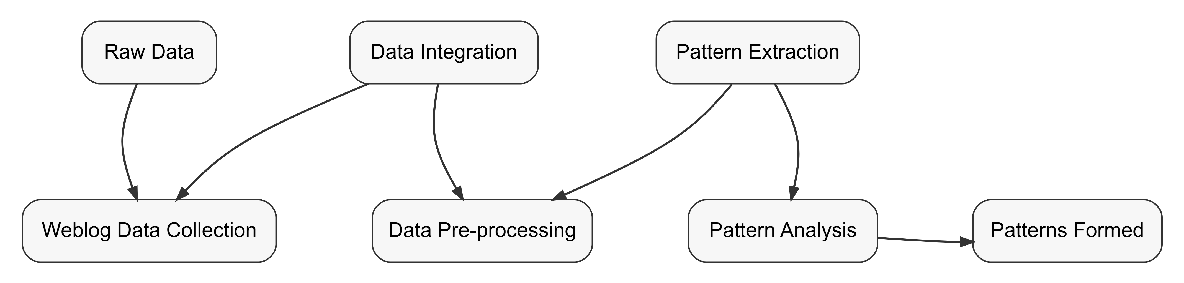
Web Mining, personalization, Social Analytics
Web Mining
Web mining is the application of data mining techniques to discover patterns from the World Wide Web.

Slide 12
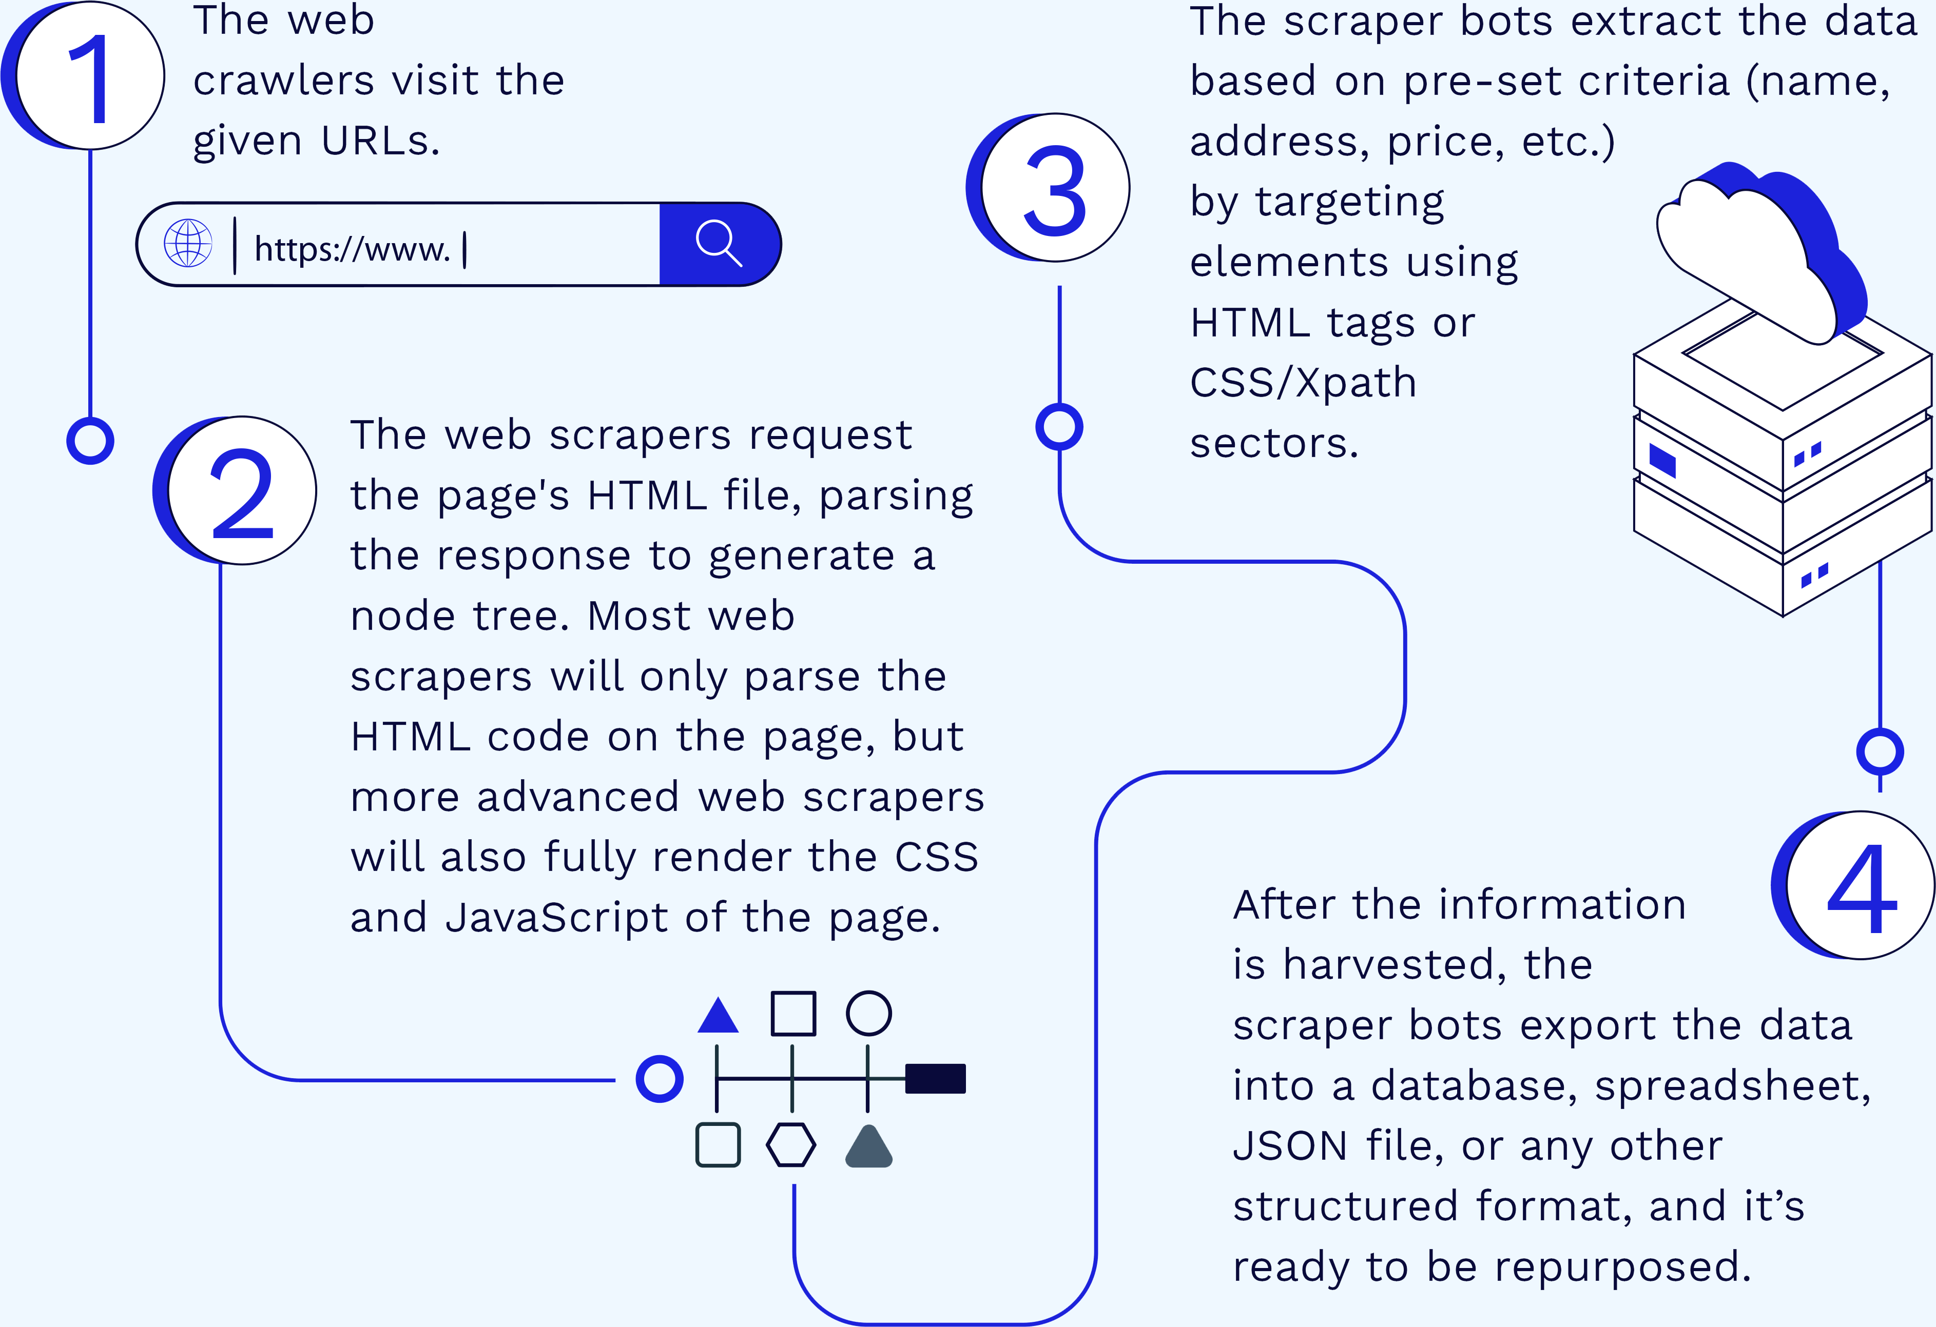
Web Content Mining (Web Scraping)
Figure 4. Web Scraping Process

Slide 13
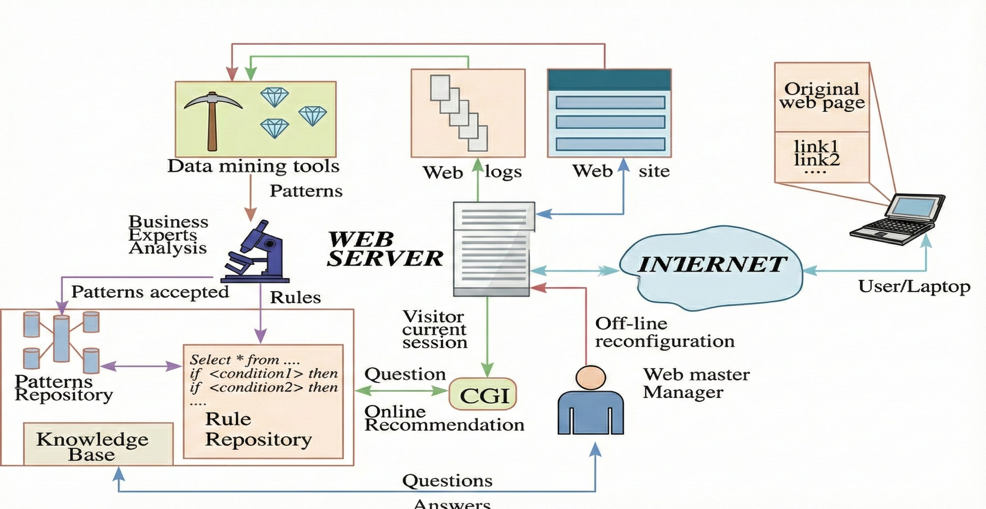
Web Usage Mining (Web Analytics)
Web usage mining (Web analytics) is the extraction of useful information from data generated through Web page visits and transactions.

Slide 14
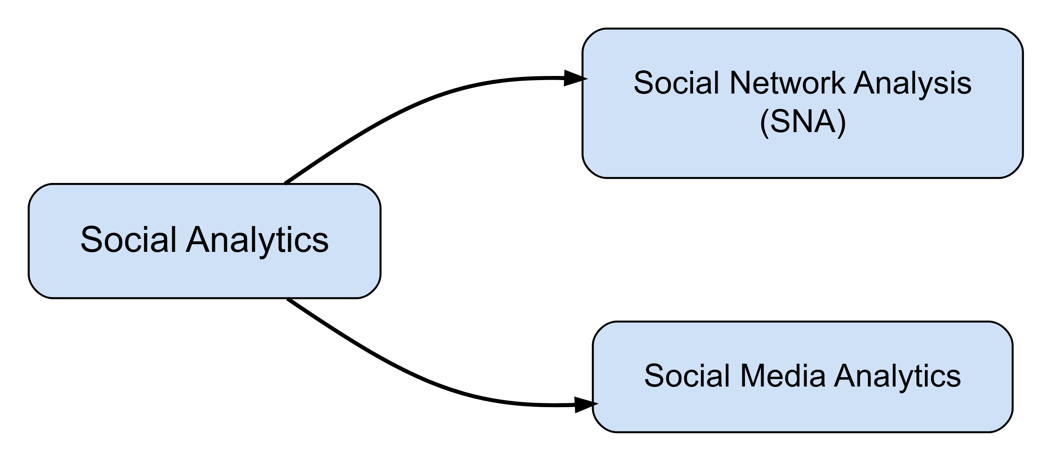
Social Analytics
Social analytics is defined as monitoring, analyzing, measuring and interpreting digital interactions and relationships of people, topics, ideas and content.

Slide 15
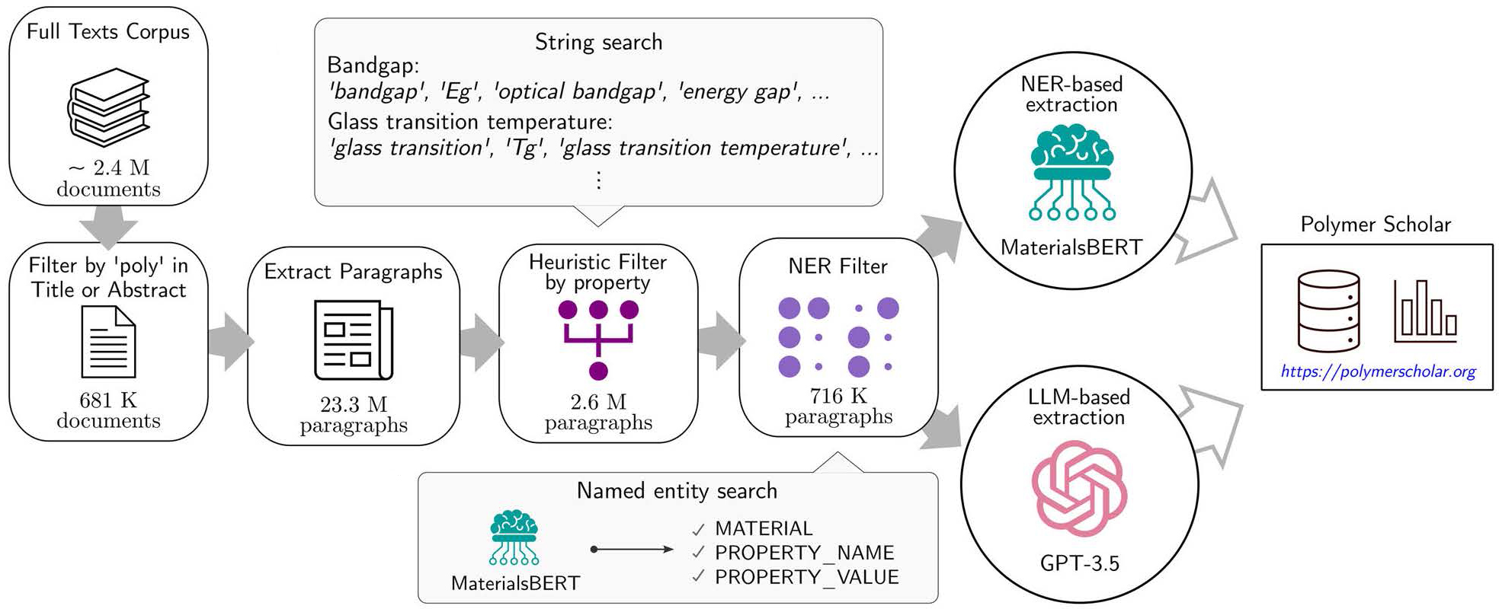
Text mining
Text Mining Concepts
85-90 percent of all corporate data is in some kind of unstructured form (e.g., text)
Unstructured corporate data is doubling in size every 18 months
Tapping into these information sources is not an option, but a need to stay competitive
Note
Text mining is the process of deriving high-quality information from text. High-quality information is typically derived through the devising of patterns and trends through means such as statistical pattern learning.
Knowledge Discovery from Web Data
Figure 5. Example Data exploration workflow for textual data extraction (Gupta et al. 2024)

Slide 16
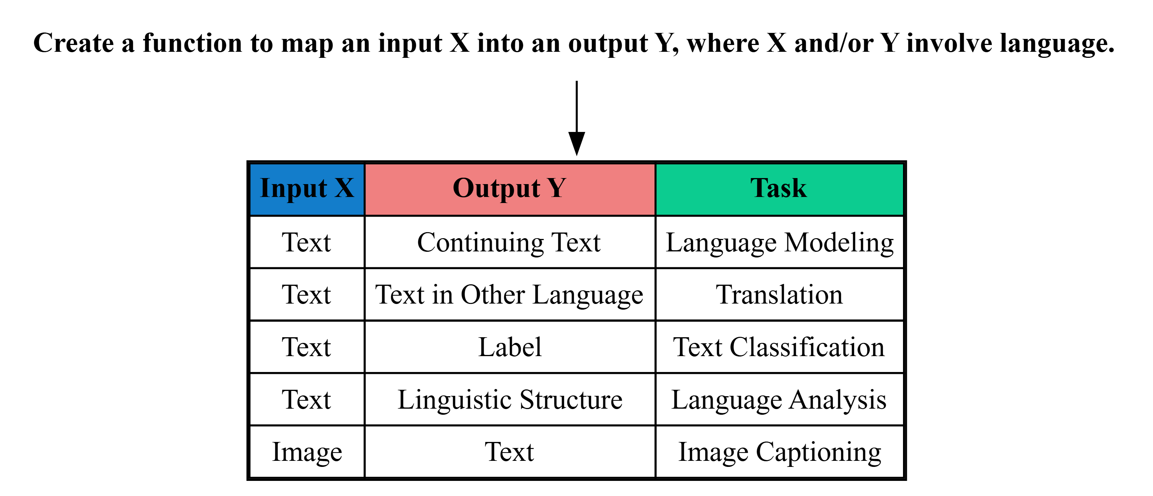
Natural Language Processing (NLP)
What is Natural Language Processing (NLP)?
Technology that enables computers to process, generate, and interact with language (e.g., text). Some key aspects:
Learn useful representations: capture meaning in a structured way that can be used for downstream tasks (e.g., embeddings used to classify a document)
Generate language: create language (e.g., text,
code) for tasks like dialogue, translation, or question answering.
Bridge language and action: Use language to perform tasks, solve problems, interact with environments (e.g., a code IDE)
General NLP Framework

Slide 17
Building NLP Systems
Rules: Manual creation of rules
def classify(x: str) -> str: sports_keywords = ["baseball", "soccer", "football", "tennis"] if any(keyword in x for keyword in sports_keywords): return "sports" else: return "other"
Prompting: Prompting a language model w/o training

Slide 18
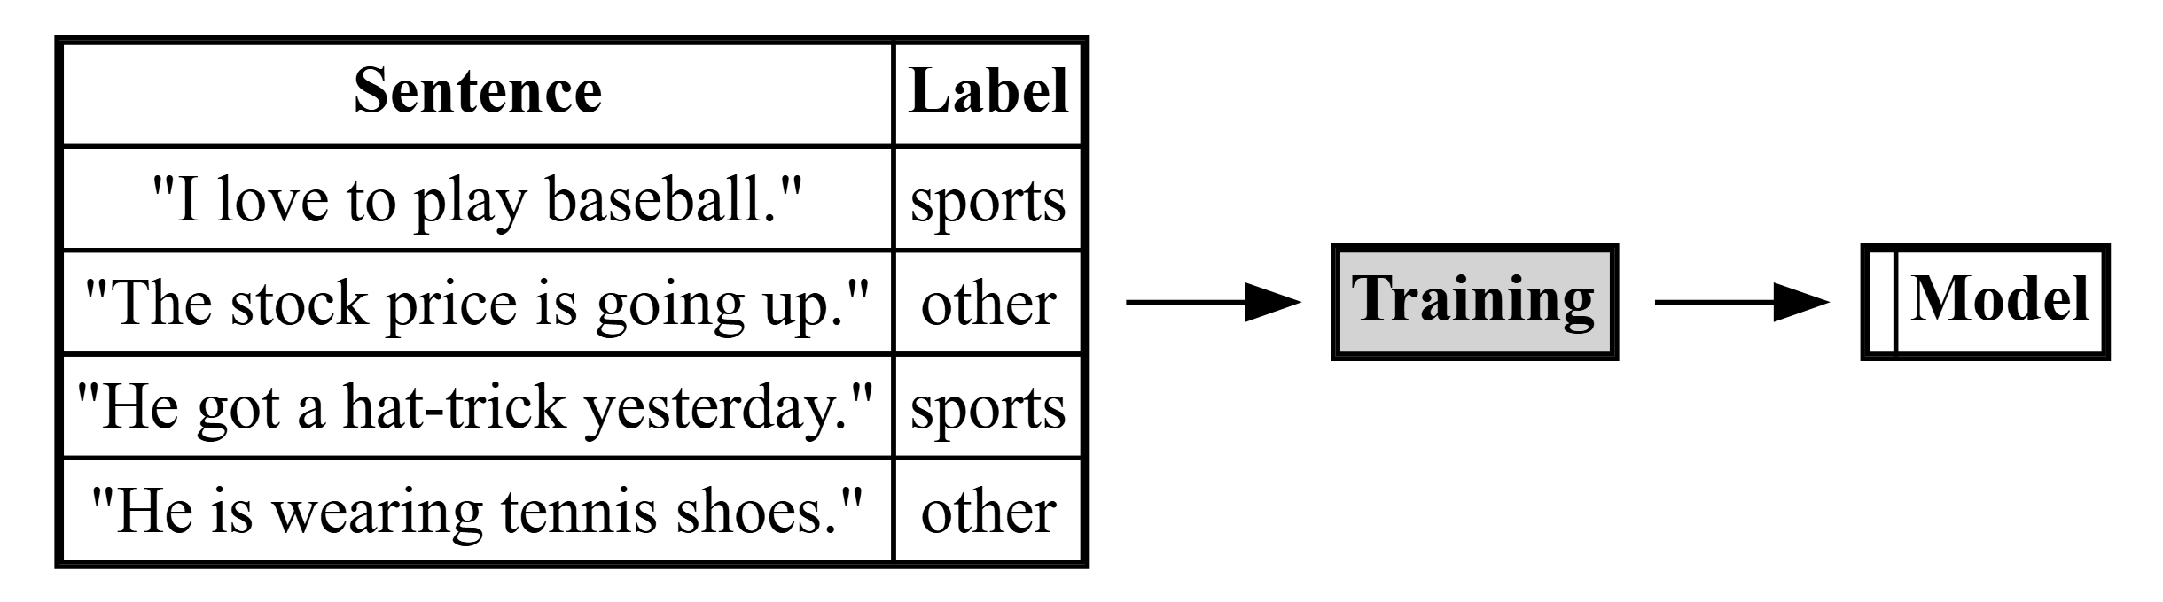
Building NLP Systems
Fine-tuning: Machine learning from paired data $⟨X,Y⟩$

Slide 19
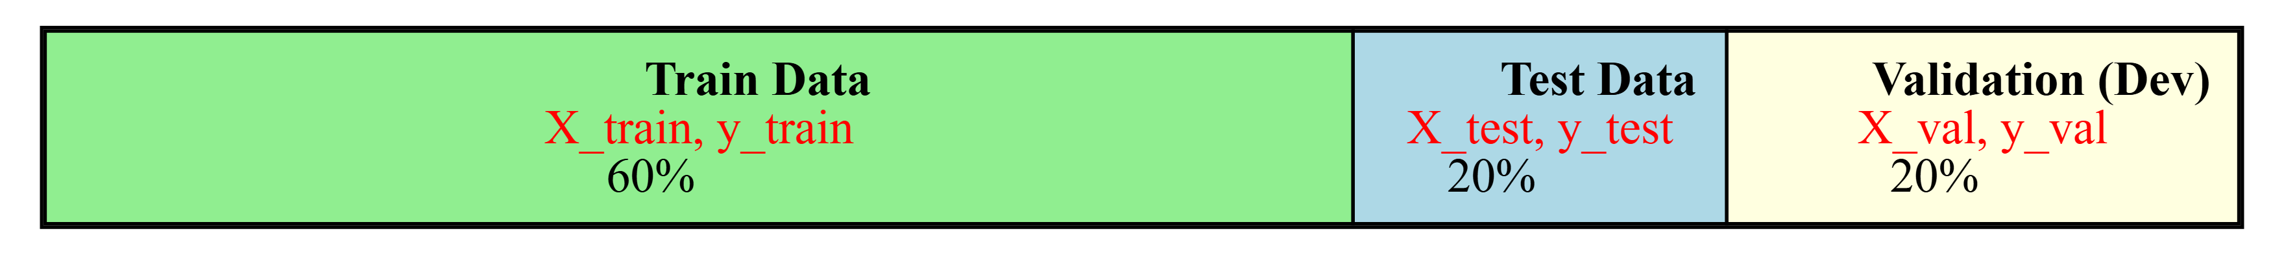
Data Requirements for System Building
Rules/prompting based on intuition: No data needed, but also no performance guarantees
Rules/prompting based on spot-checks: A small amount of data with input $X$ only
Rules/prompting with rigorous evaluation: Development set with input $X$ and output $Y$ (e.g. 200-2000 examples). Additional held-out test set also preferable.
Fine-tuning: Additional train set. More is often better - constant accuracy increase when data size doubles.

Slide 20
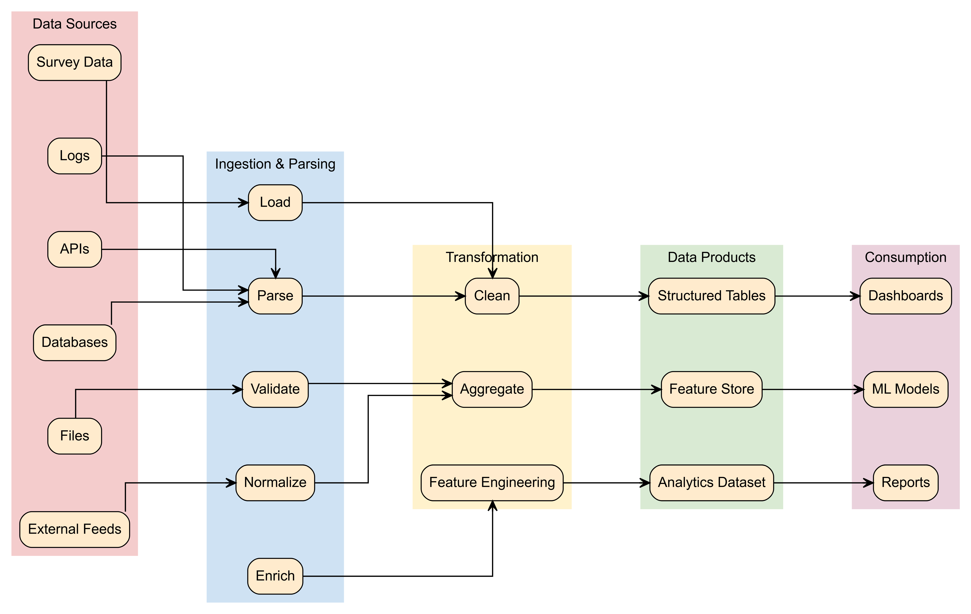
Natural Language Processing (NLP) Pipeline

Slide 21
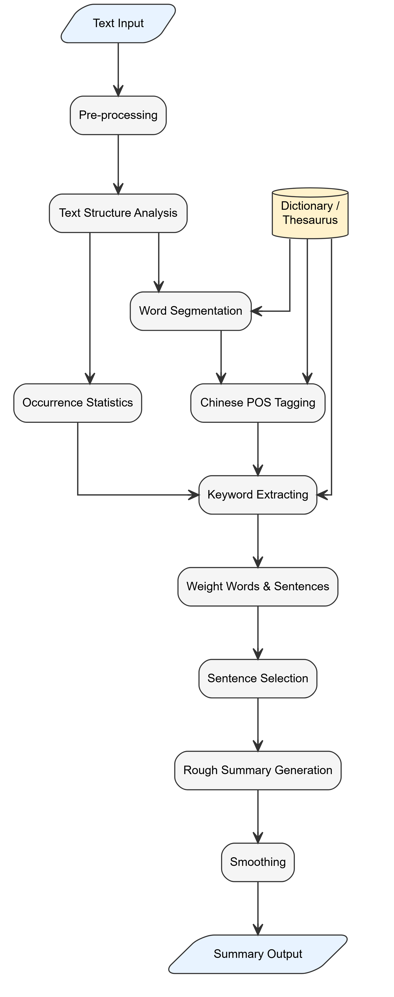
Text Summarization

Slide 22
Documents

Slide 23
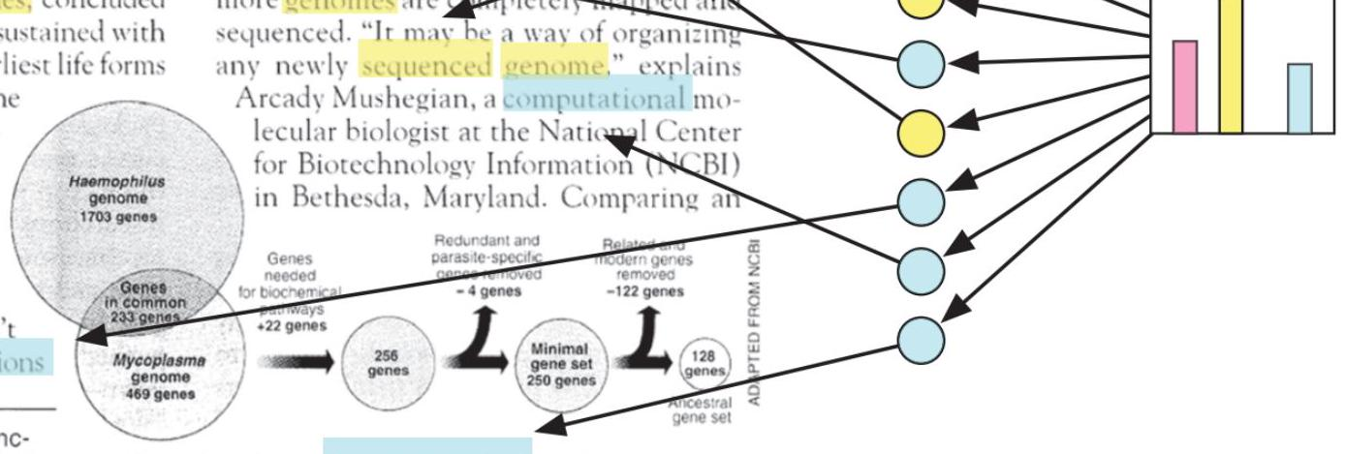
Topic proportions and assignments
Seeking Life’s Bare (Genetic) Necessities
Cold Spring Harbor, New York- “are not all that far apart,” especially in How many genes does an organism need to comparison to the 75,000 genes in the husurvive? Last week at the genome meeting here,* two genome researchers with radically different approaches presented complementary views of the basic genes needed for life. One research team, using computer analyses to compare known genomes, concluded that today’s organisms can be sustained with just 250 genes, and that the earliest life forms required a mere 128 genes. The other researcher mapped genes in a simple parasite and estimated that for this organism, 800 genes are plenty to do the job-but that anything short of 100 wouldn’t be enough.
Although the numbers don’t match precisely, those predictions
Genome Mapping and Sequencing, Cold Spring Harbor, New York, May 8 to 12.

Slide 24
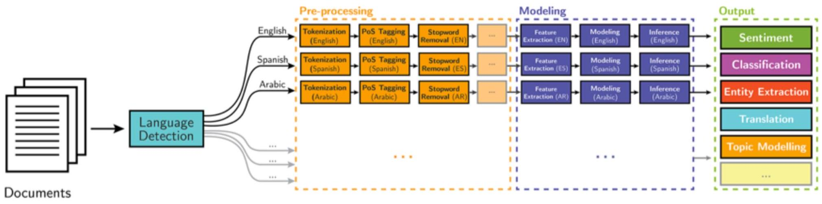
Stripping down. Computer analysis yields an estimate of the minimum modern and ancient genomes.
[^0] ## Natural Language Processing (NLP)
Part-of-speech tagging
Text segmentation
Word sense disambiguation
Syntactic ambiguity
Imperfect or irregular input
Speech acts
NLP Tasks
Question answering
Automatic summarization
Natural language generation
Natural language understanding
Machine translation
Foreign language reading
Foreign language writing.
Speech recognition
Text-to-speech
Text proofing
Optical character recognition
Classical NLP

Slide 25
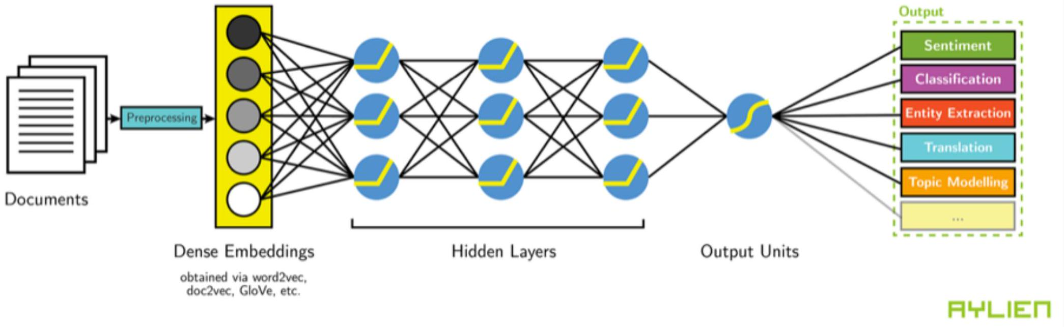
Deep Learning-based NLP

Slide 26
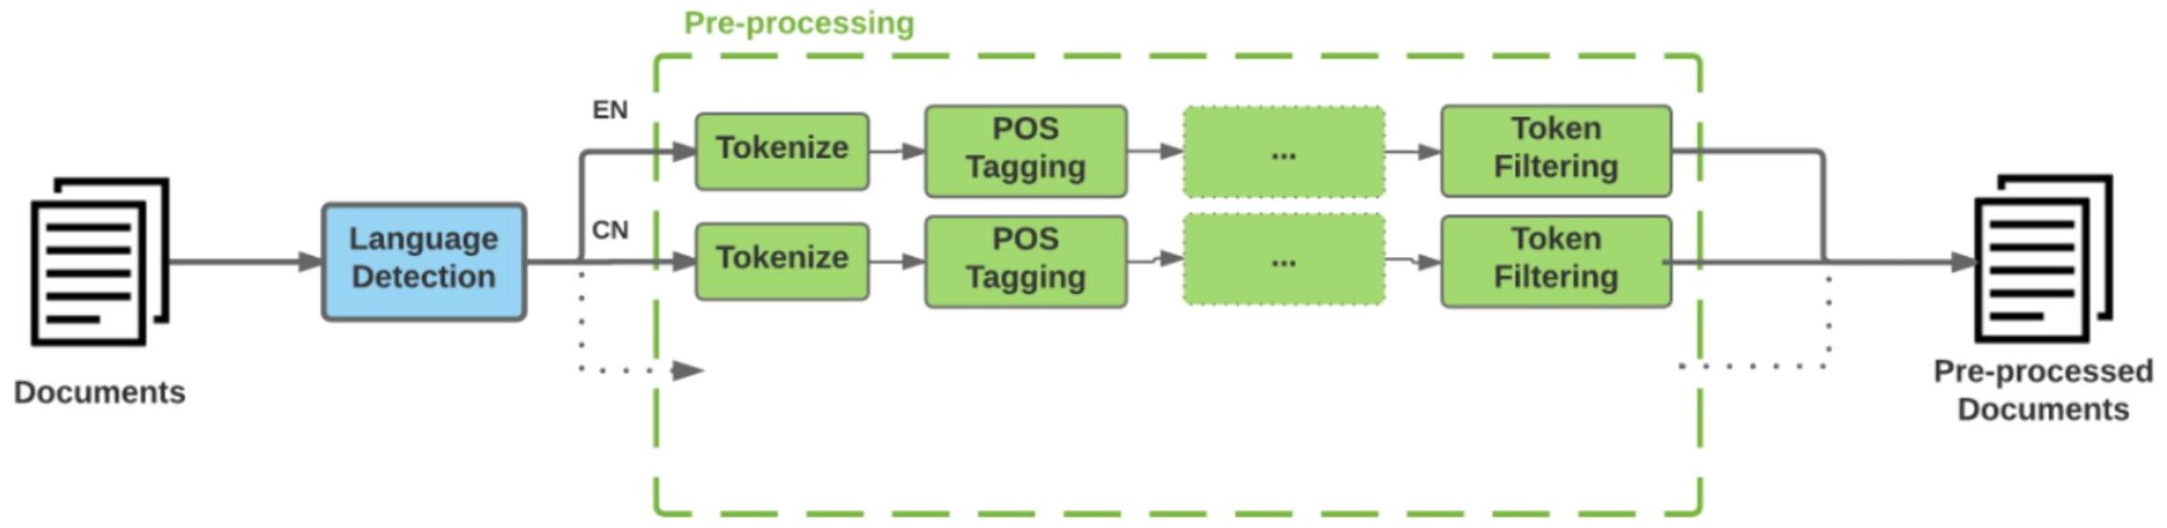
Modern NLP Pipeline

Slide 27
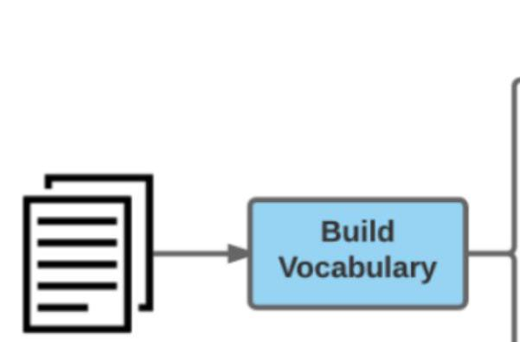
Task / Output

Slide 28
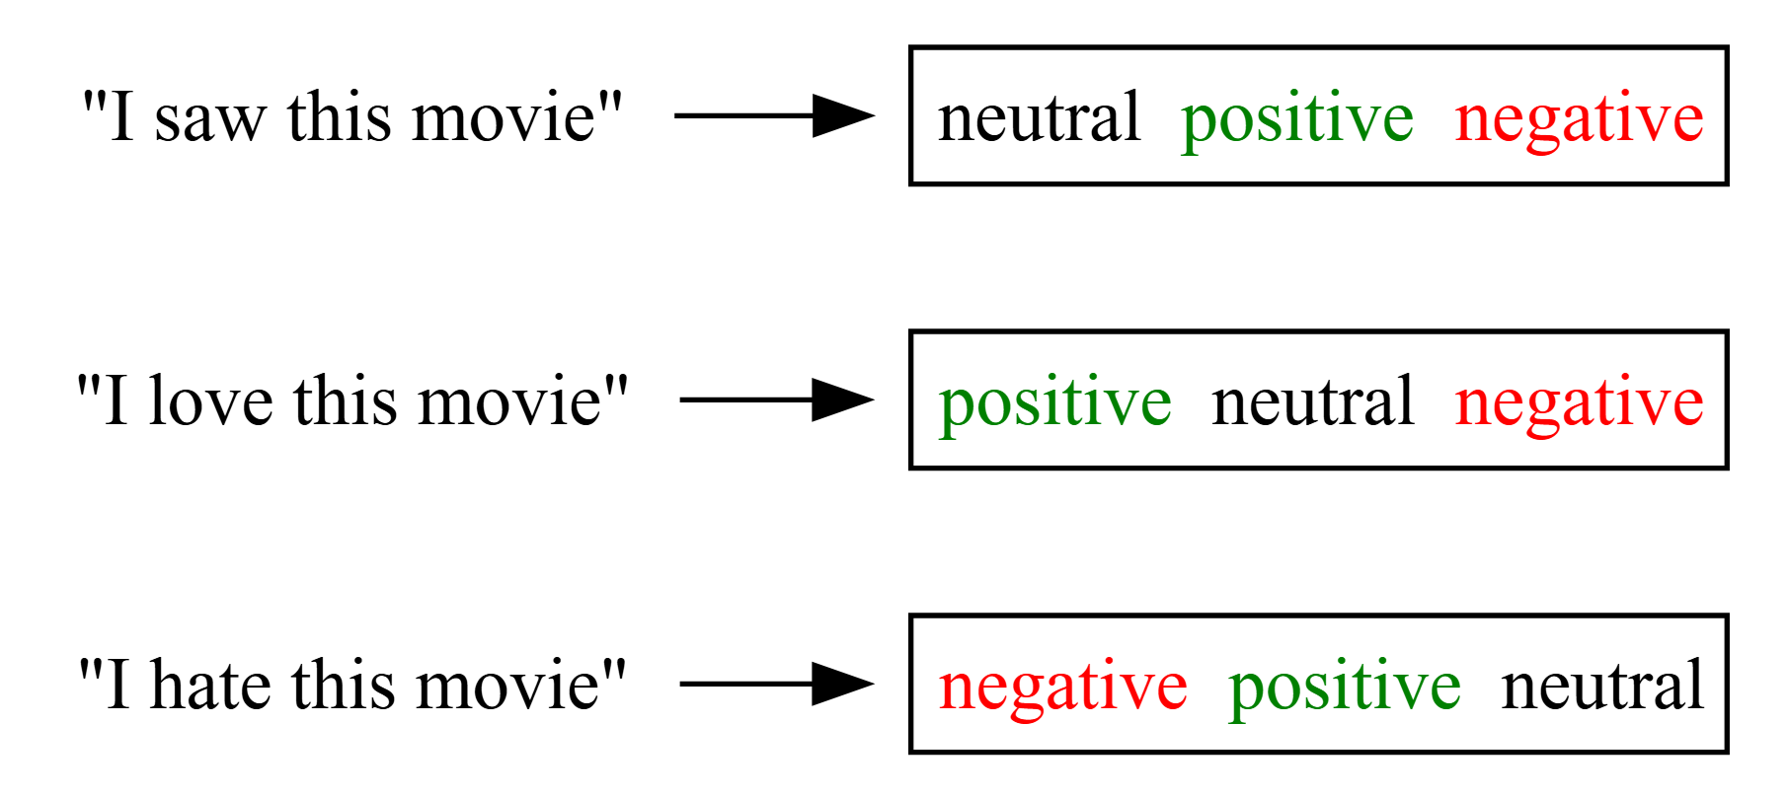
Task / Output
Modern NLP Pipeline
Task / Output
Deep Learning NLP
Task / Output
Classification
Sentiment Analysis
Entity Extraction
Topic Modeling
Document Similarity
Rule Based Sentiment
Note
Given a review ($X$) on a movie ratings website, decide whether its label ($y$) is positive (1), negative (-1) or neutral (0).

Slide 29
Natural Language Processing Pipeline
Natural Language Processing Pipeline
Figure 6. NLP Pipeline

Slide 30
Sentiment Classification
Text Information
def read_xy_data(filename: str) -> tuple[list[str], list[int]]: x_data = [] y_data = [] with open(filename, 'r') as f: for line in f: label, text = line.strip().split(' ||| ') x_data.append(text) y_data.append(int(label)) return x_data, y_data x_train, y_train = read_xy_data('./data/sentiment-treebank/train.txt') x_test, y_test = read_xy_data('./data/sentiment-treebank/dev.txt') print("Document:-", x_train[0]) print("Label:-", y_train[0])
Document:- The Rock is destined to be the 21st Century 's new `` Conan '' and that he 's going to make a splash even greater than Arnold Schwarzenegger , Jean-Claud Van Damme or Steven Segal . Label:- 1
Segmentation, Tokenization, and Cleaning
def extract_features(x: str) -> dict[str, float]: features = {} x_split = x.split(' ') # Count the number of "good words" and "bad words" in the text good_words = ['love', 'good', 'nice', 'great', 'enjoy', 'enjoyed'] bad_words = ['hate', 'bad', 'terrible', 'disappointing', 'sad', 'lost', 'angry'] for x_word in x_split: if x_word in good_words: features['good_word_count'] = features.get( 'good_word_count', 0) + 1 if x_word in bad_words: features['bad_word_count'] = features.get( 'bad_word_count', 0) + 1 # The "bias" value is always one, to allow us to assign a "default" score to the text features['bias'] = 1 return features feature_weights = {'good_word_count': 1.0, 'bad_word_count': -1.0, 'bias': 0.5}
Lines 6,8
We list the words that represent sentiment,
Lines 9-10,12-13,15
We count the number of good words and bad words in the text,
Line 18
We add a bias term to allow us to assign a “default” score to the text.
Decision ML Algorithm
def run_classifier(x: str) -> int: score = 0 for feat_name, feat_value in extract_features(x).items(): score = score + feat_value * feature_weights.get(feat_name, 0) if score > 0: return 1 elif score < 0: return -1 else: return 0 def calculate_accuracy(x_data: list[str], y_data: list[int]) -> float: total_number = 0 correct_number = 0 for x, y in zip(x_data, y_data): y_pred = run_classifier(x) total_number += 1 if y == y_pred: correct_number += 1 return correct_number / float(total_number)
Results
label_count = {} for y in y_test: if y not in label_count: label_count[y] = 0 label_count[y] += 1 print(label_count) train_accuracy = calculate_accuracy(x_train, y_train) test_accuracy = calculate_accuracy(x_test, y_test) print(f'Train accuracy: {train_accuracy}') print(f'Dev/test accuracy: {test_accuracy}') # Display 4 decimal print(f'Train accuracy: {train_accuracy:.4f}') print(f'Dev/test accuracy: {test_accuracy:.4f}')
{1: 444, 0: 229, -1: 428} Train accuracy: 0.4345739700374532 Dev/test accuracy: 0.4214350590372389 Train accuracy: 0.4346 Dev/test accuracy: 0.4214
Model Evaluation
import random def find_errors(x_data, y_data): error_ids = [] y_preds = [] for i, (x, y) in enumerate(zip(x_data, y_data)): y_preds.append(run_classifier(x)) if y != y_preds[-1]: error_ids.append(i) for _ in range(5): my_id = random.choice(error_ids) x, y, y_pred = x_data[my_id], y_data[my_id], y_preds[my_id] print(f'{x}\ntrue label: {y}\npredicted label: {y_pred}\n') find_errors(x_train, y_train)
Some movies can get by without being funny simply by structuring the scenes as if they were jokes : a setup , delivery and payoff . true label: 0 predicted label: 1 Spectators will indeed sit open-mouthed before the screen , not screaming but yawning . true label: -1 predicted label: 1 This thing is just garbage . true label: -1 predicted label: 1 Auto Focus is not your standard Hollywood bio-pic . true label: 0 predicted label: 1 It would take a complete moron to foul up a screen adaptation of Oscar Wilde 's classic satire . true label: -1 predicted label: 1
Improving the Model
What’s going wrong with my system?
Modify the system (featurization, scoring function, etc.)
Measure accuracy improvements, accept/reject change
Repeat from 1
Finally, when satisfied with dev accuracy, evaluate on test

Slide 31
Extreme or Rare Cases
Linguistic Barriers
Low-frequency Words
Conjugation
Negation
Metaphor
Analogy
Symbolic Languages
Tip
Can we think of solutions for these?

Slide 32
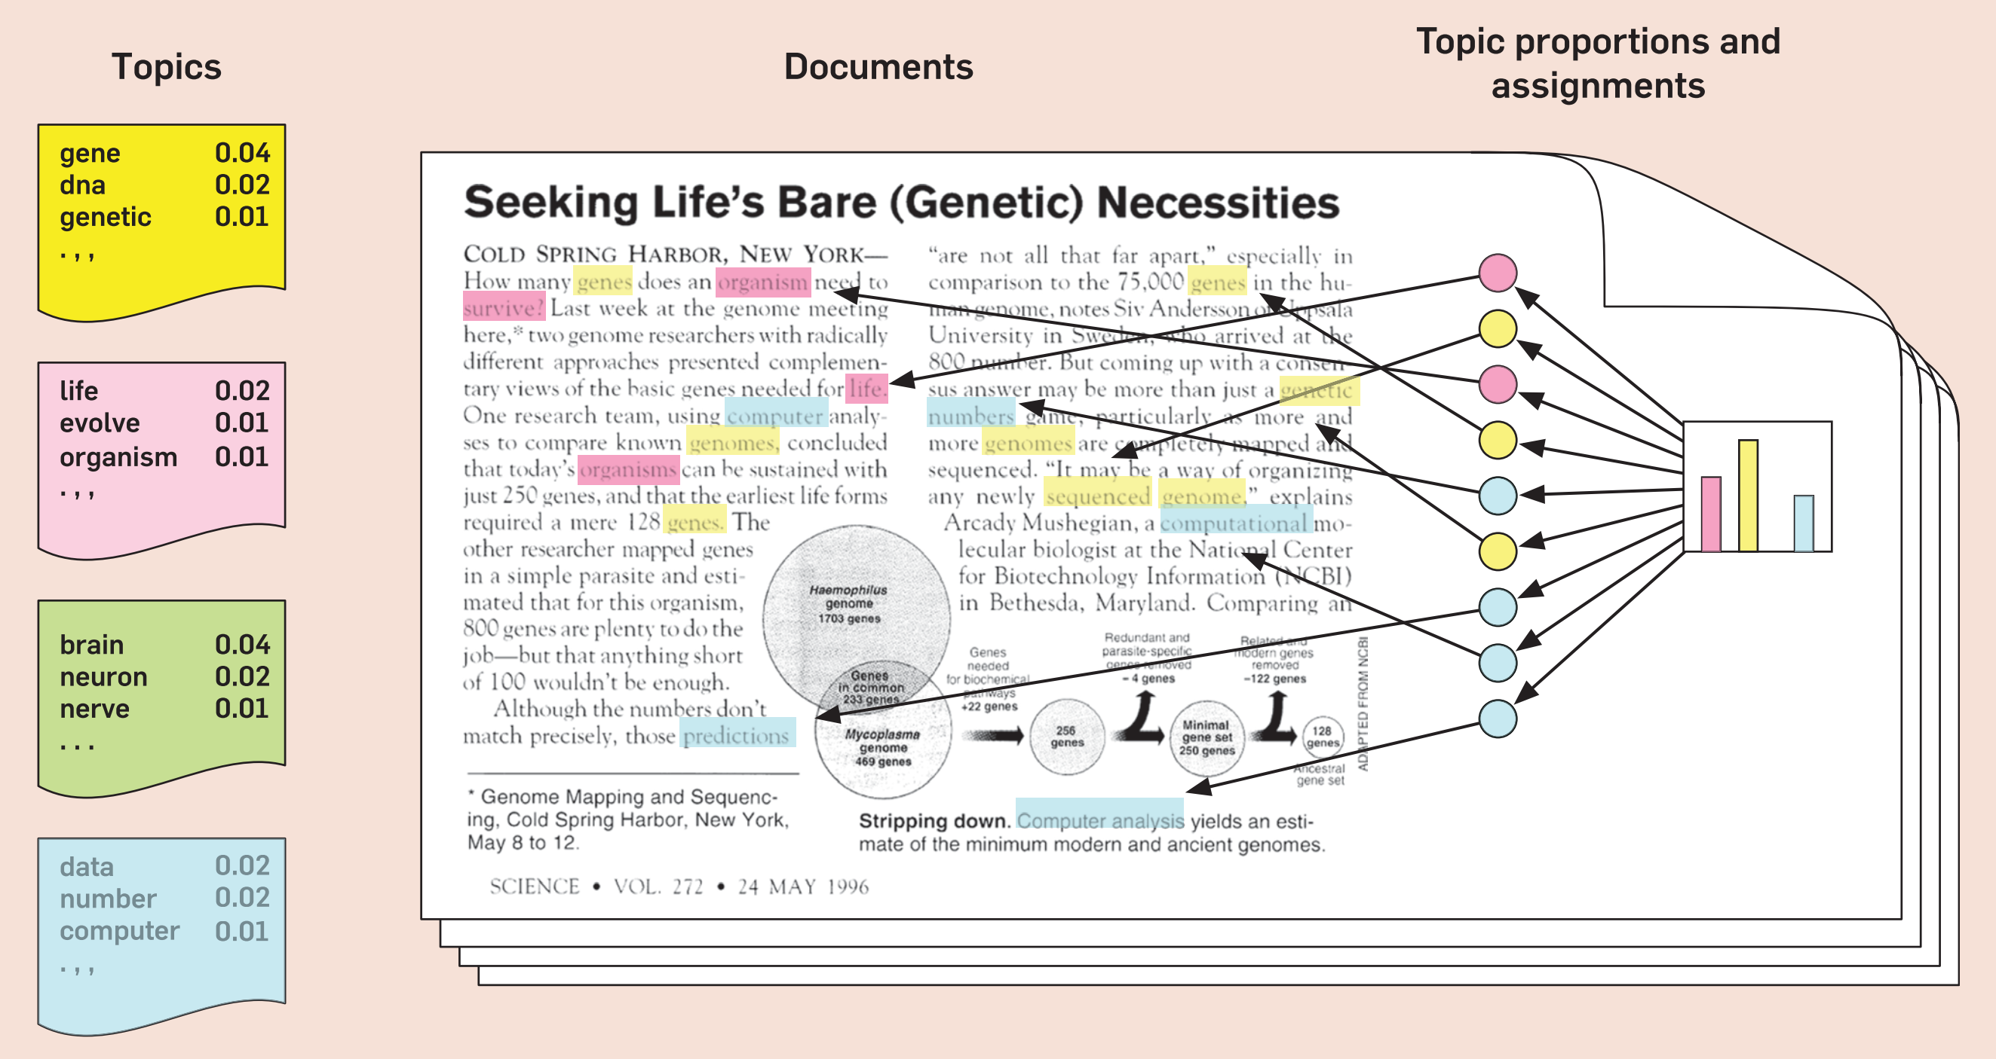
Probabilistic Topic Modeling
Probabilistic Topic Modeling
Figure 7. Probabilistic Topic Modeling

Slide 33
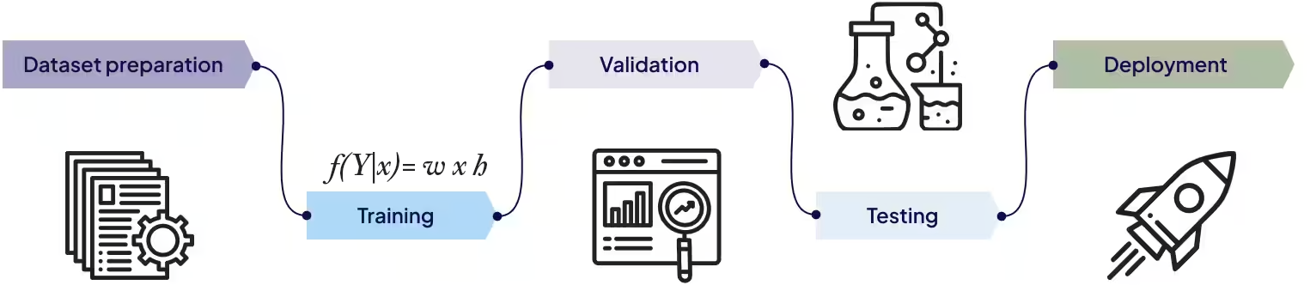
Machine Learning
We want to estimate a function that will predict the label of a given text relatively well.
The function $f\left(x\right)$ can be linear or non-linear.
It can be defined by humans or learned from data.
Figure 8. Machine Learning

Slide 34
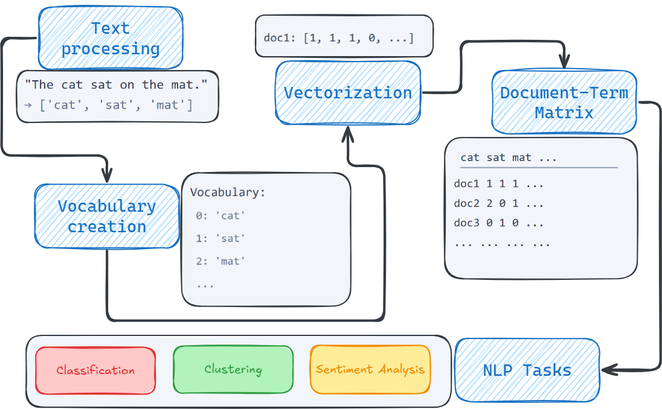
Bag of Words approach
What is Bag of Words?
Text is treated as a collection (bag) of words
Word order is discarded
Each document becomes a vector of word counts
Figure 9. Bag of Words

Slide 35
Why We Need Bag of Words
Machines do not understand text
Models require fixed-length numeric vectors
Bag of Words is the first workable bridge between language and math
“Meaning is ignored; frequency is preserved.”

Slide 36
Text Cleaning

Slide 37
None
Despite suffering a sense-of-humour failure , The Man Who Wrote Rocky does not deserve to go down with a ship as leaky as this .
None
despite suffering a sense of humour failure the man who wrote rocky does not deserve to go down with a ship as leaky as this
Lowercasing
Removing punctuation
Removing numbers
Removing stopwords (optional)

Slide 38
Stanford Text Corpus Import
import random def sample_sentences(x, y, n=4, seed=42): random.seed(seed) idx = random.sample(range(len(x)), n) return [(y[i], x[i]) for i in idx] samples = sample_sentences(x_train, y_train, n=4) for i, (label, text) in enumerate(samples, 1): print(f"S{i} [label={label}]: {text}")
S1 [label=1]: With Dickens ' words and writer-director Douglas McGrath 's even-toned direction , a ripping good yarn is told . S2 [label=0]: Maybe Thomas Wolfe was right : You ca n't go home again . S3 [label=-1]: Despite suffering a sense-of-humour failure , The Man Who Wrote Rocky does not deserve to go down with a ship as leaky as this . S4 [label=1]: It will guarantee to have you leaving the theater with a smile on your face .
Import all documents in the corpus.
Make sure they are stored in the right format.
Tokenization
Breaking text into units
Split text into tokens (usually words)
Simple whitespace tokenization is often enough
More advanced methods exist (e.g., subword tokenization)
Tokens are the building blocks for Bag of Words
Example: “I love NLP!” $→$ [“I”, “love”, “NLP”]

Slide 39
 | again | and | as | ca | deserve | despite | dickens | direction
S1 | 0 | 1 | 0 | 0 | 0 | 0 | 1 | 1
S2 | 1 | 0 | 0 | 1 | 0 | 0 | 0 | 0
S3 | 0 | 0 | 2 | 0 | 1 | 1 | 0 | 0
S4 | 0 | 0 | 0 | 0 | 0 | 0 | 0 | 0
Building CountVectorizer
from sklearn.feature_extraction.text import CountVectorizer import pandas as pd docs = [text for _, text in samples] vectorizer = CountVectorizer( lowercase=True, stop_words=None # keep everything for teaching clarity ) X = vectorizer.fit_transform(docs) bow_df = pd.DataFrame( X.toarray(), columns=vectorizer.get_feature_names_out(), index=[f"S{i+1}" for i in range(len(docs))] ) bow_df.iloc[:, 0:8]

Slide 40
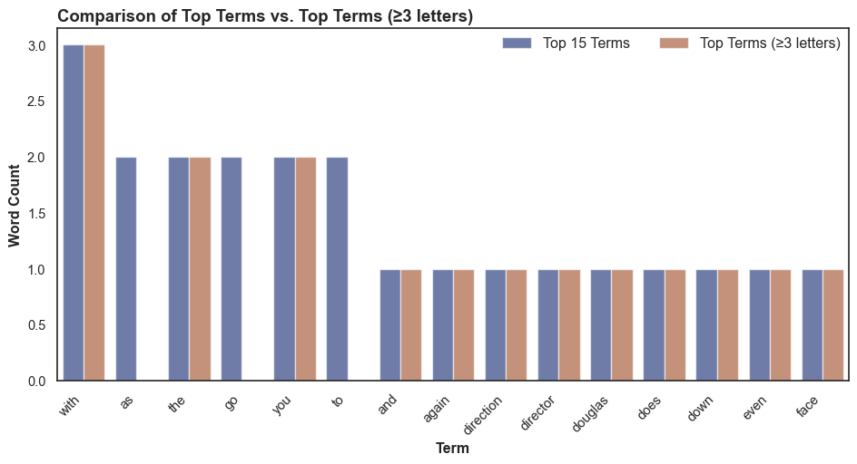
Vocabulary Construction
Vocabulary = unique words across all documents
Vocabulary size grows quickly
Rare words may be removed
Vocabulary ≈ feature space
Too large → sparse, inefficient models
Counting Words - Document-Term Matrix (DTM)
Rows = documents
Columns = vocabulary terms
Values = word counts
This is the actual model input.
Word Frequencies

Slide 41
What BoW Gets Right

Slide 42
Strengths
Simple and interpretable
Fast to compute
Works surprisingly well for:
sentiment analysis
topic classification
spam detection
Limitations
Ignores word order
Ignores meaning
Vocabulary explosion
Sparse matrices
Classic failure: “not good” ≈ “good”

Slide 43
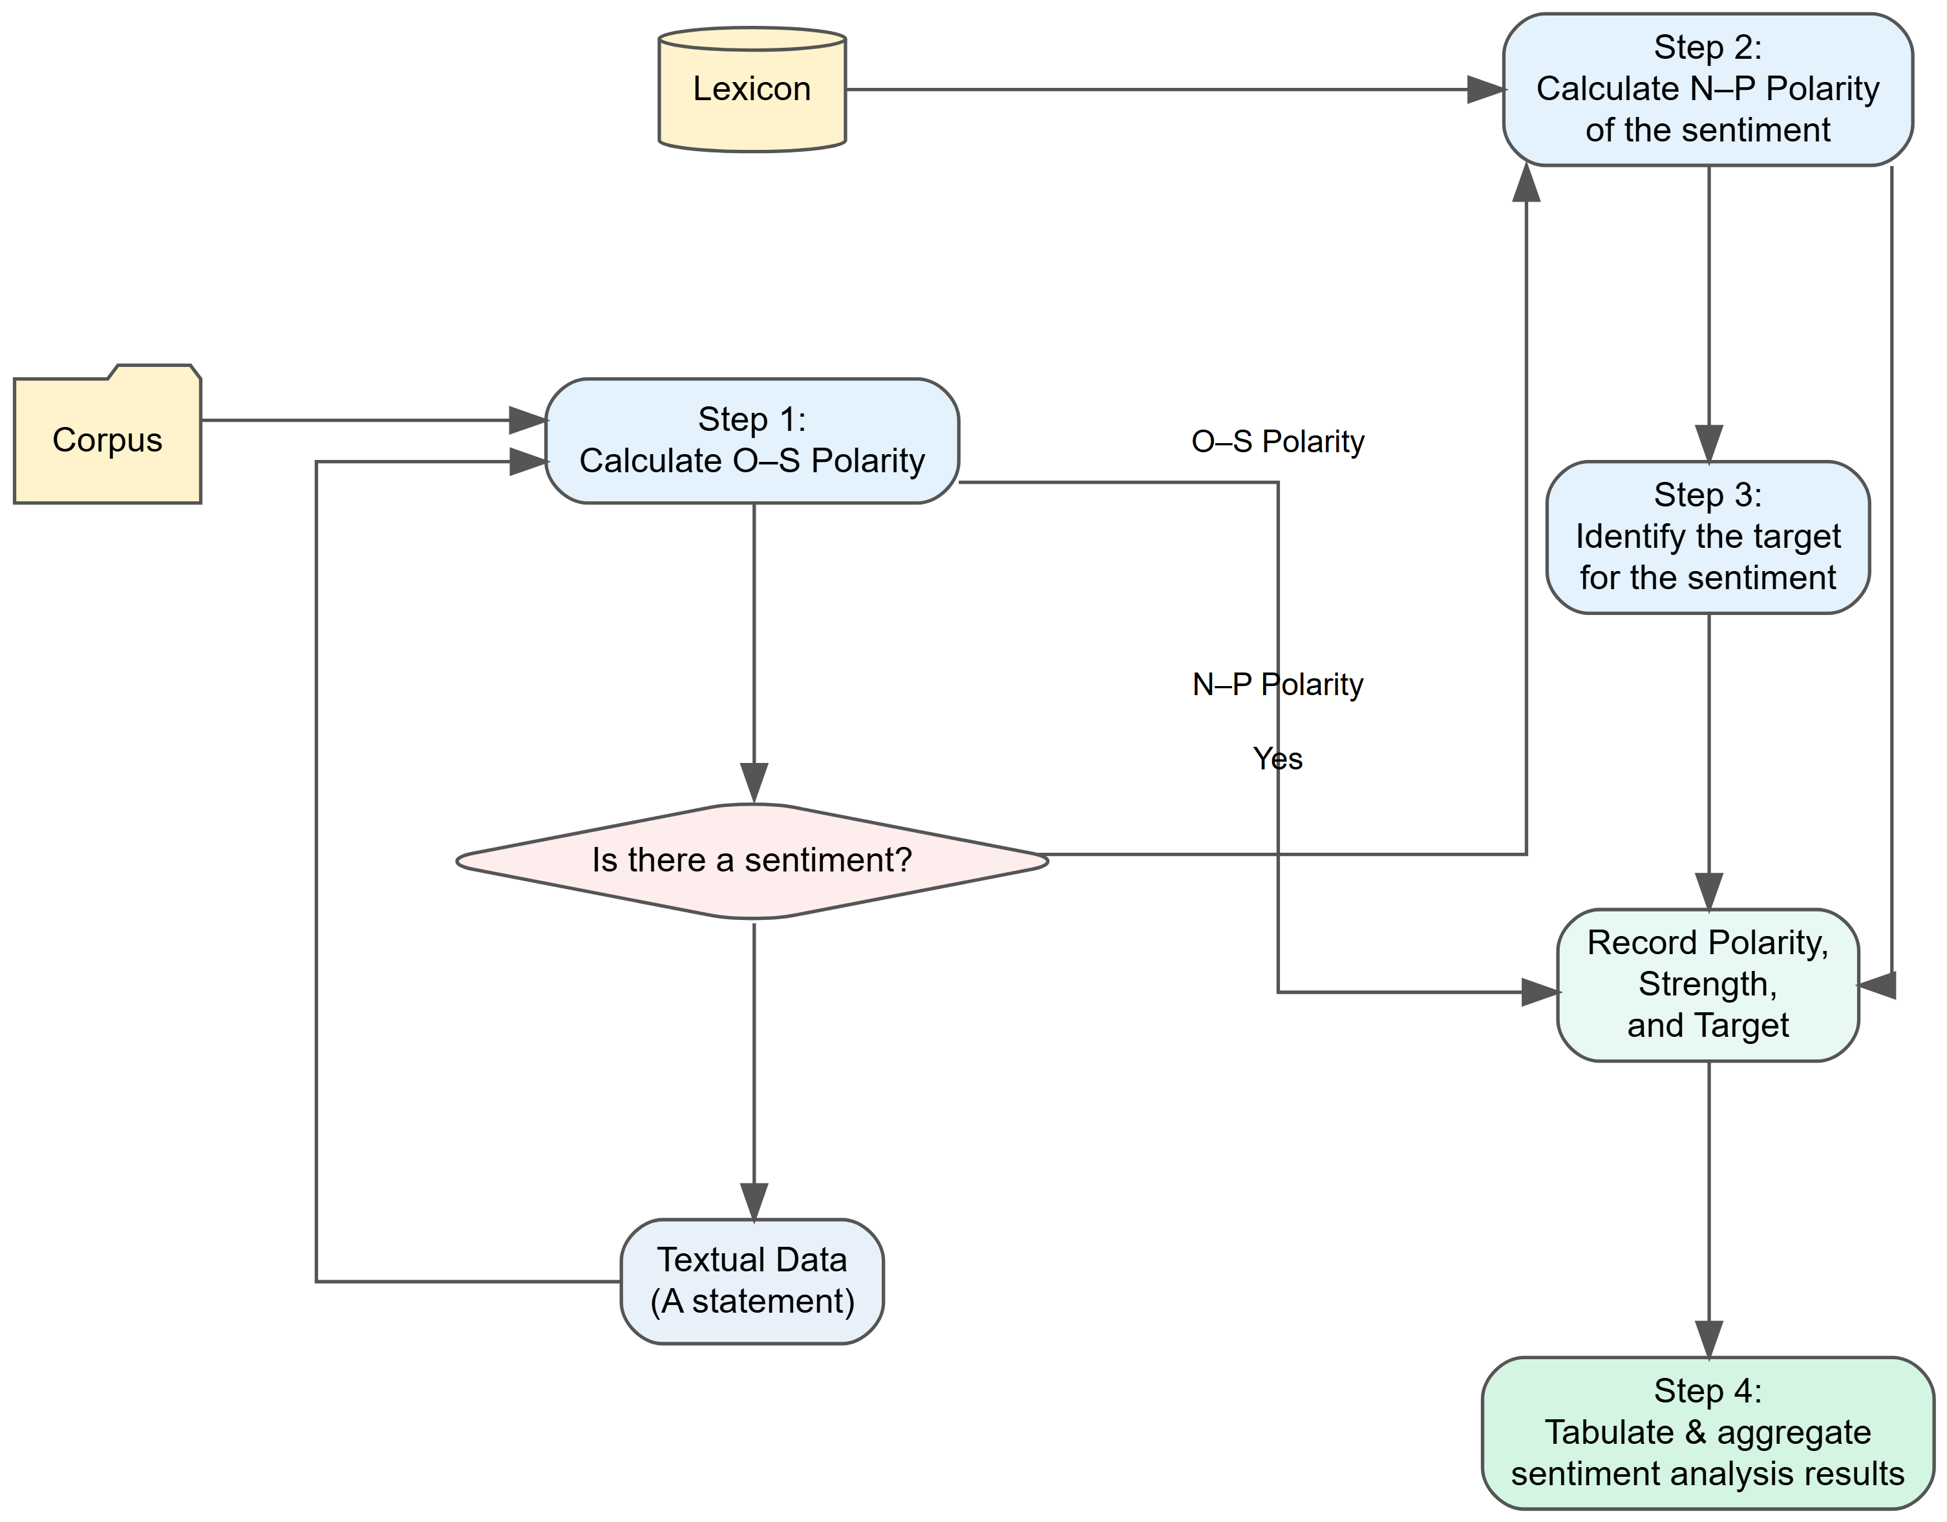
BoW in Practice (Sentiment Analysis)

Slide 44
When Should You Use BoW?

Slide 45
When to Use Bag of Words
Dataset is small to medium
Interpretability matters
You need a fast baseline
Text is short and structured
When Not to Use Bag of Words
Long documents
Semantic nuance matters
Context is critical

Slide 46
Conceptual Takeaway
Bag of Words is not about language—it is about counting.
Bag of words is a stepping stone to more advanced techniques:
TF-IDF (weighting counts)
Embeddings (learning meaning)
Transformers (learning context)

Slide 47
References
Gupta, S., Mahmood, A., Shetty, P., Adeboye, A., and Ramprasad, R. 2024. “Data Extraction from Polymer Literature Using Large Language Models,” Communications Materials (5), Nature Publishing Group, p. 269. (https://doi.org/10.1038/s43246-024-00708-9).
Talib, R., Hanif, M. K., Ayesha, S., and Fatima, F. 2016. “Text Mining: Techniques, Applications and Issues,” International Journal of Advanced Computer Science and Applications (7:11), The Science; Information Organization, pp. 414–418.

